Slide 1


AMC ENGINEERING COLLEGE
Department of ECE
MACHINE LEARNING INTERNSHIP
Presentation on
“LOAN PREDICTION”
Under the guidance of :
MR. AKASH V
Presented by:
PRADEEP NALAWADE
1AM22EC086

Slide 2
CONTENTS
Abstract
Introduction
Company Profile
Problem Statement
Objective
Dataset
Libraries Used
Implementation (Code)
Conclusion

Slide 3
ABSTRACT
This project focuses on predicting loan approval outcomes using machine learning techniques. The dataset contains applicant details such as gender, income, education, credit history, employment status, and loan amount. After preprocessing the data and analyzing key patterns, various classification models like Logistic Regression, Decision Tree, Random Forest, and SVM were developed and evaluated. Among them, [insert best model here] showed the highest accuracy. The project highlights how machine learning can assist financial institutions in making faster, more consistent, and data-driven loan decisions, reducing manual workload and improving overall efficiency.

Slide 4
INTRODUCTION
Understanding the factors that influence loan approval decisions is crucial for financial
institutions to manage risk and serve clients effectively. The Loan Prediction dataset offers
insights into how demographic, financial, and credit-related features affect loan outcomes. It includes attributes such as gender, marital status, education level, applicant income, loan amount, credit history, and property area. By leveraging machine learning techniques, we aim to uncover patterns and predictors that determine whether a loan should be approved. This project explores the dataset, applies preprocessing and modeling techniques, and evaluates predictive performance to support smarter, data-driven decisions in the banking sector.

Slide 5

COMPANY PROFILE
Name : PRINSTON SMART ENGINEERS
Main office :Vishnuvardhan Statue Rd, Vishwa Priya Nagar, Begur, Bengaluru, Karnataka, 560068
Phone : 9513106196
Email : Prinston.Smart@gmail.com
Contact Person: Mrs. Farheen Farhath (Managing Director)
Year stand up : 2004
Company category : IT Software/ Embedded

Slide 6
PROBLEM STATEMENT
In the banking and financial sector, loan approval is a critical process that traditionally relies on manual assessment of an applicant’s financial background and creditworthiness. This approach is time-consuming, prone to human bias, and inconsistent. The goal of this project is to develop an automated loan prediction system using machine learning algorithms that can accurately predict whether a loan application will be approved based on various input features such as income, employment status, credit history, loan amount, and more. By analyzing historical loan application data, the system aims to identify key patterns and decision factors to assist banks in making faster, fairer, and more reliable loan approval decisions.

Slide 7
OBJECTIVES
To analyze and understand the key factors that influence loan approval decisions based on historical applicant data.
To preprocess the dataset by handling missing values, encoding categorical variables, and performing feature scaling where necessary.
To perform exploratory data analysis (EDA) to identify trends, correlations, and insights that can guide model development.
To build and compare multiple machine learning models (such as Logistic Regression, Decision Tree, Random Forest, SVM, and KNN) for predicting loan approval status.
To evaluate model performance using metrics such as accuracy, precision, recall, F1-score, and confusion matrix.

Slide 8
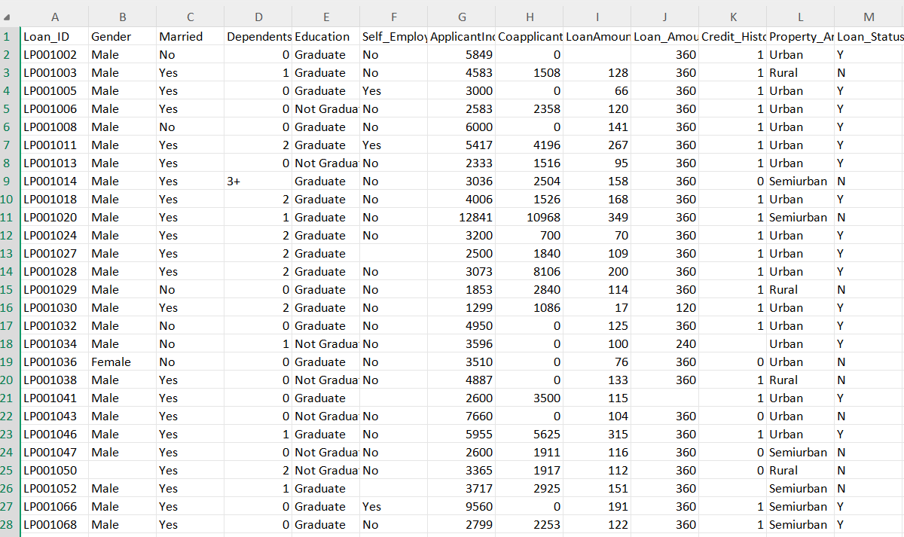
DATASET

Slide 9
LIBRARIES
Pandas: Pandas is a powerful library for data manipulation and analysis. Pandas can be used to load mutual fund data from CSV files and preprocess the data for machine learning models.
sklearn.model_selection: to split our data into train and test sets where feature variables are given as input in the method.
sklearn.linear_model:performing machine learning with linear models.
sklearn.metrics:implements several loss, score, and utility functions to measure classification
Numpy: is a powerful open-source Python library used for numerical and scientific computing. It provides support for multidimensional arrays and a wide variety of mathematical functions to operate on these arrays efficiently.
Matplotlib
Plotting and visualization library for creating static, interactive, and animated graphs

Slide 10
IMPLEMENTATION
#importing
import pandas as pd
import numpy as np
import matplotlib.pyplot as plt
import seaborn as sns
from sklearn.model_selection import train_test_split
from sklearn.preprocessing import LabelEncoder
from sklearn.ensemble import RandomForestClassifier
from sklearn.metrics import accuracy_score, confusion_matrix, classification_report
# Load the dataset
df = pd.read_csv("loan_data.csv")
df.head()
# Display basic info about the dataset
df.info()

Slide 11
# Show shape (rows, columns)
df.shape
# Show descriptive statistics
df.describe()
# Check for missing values
df.isnull().sum()
# Drop Loan_ID column as it's not useful for prediction
df.drop("Loan_ID", axis=1, inplace=True)
# Identify categorical and numerical columns
categorical_cols = df.select_dtypes(include=["object"]).columns
numerical_cols = df.select_dtypes(include=["int64", "float64"]).columns
print("Categorical Columns:", categorical_cols.tolist())
print("Numerical Columns:", numerical_cols.tolist())

Slide 12
# Fill missing values
for col in categorical_cols:
df[col].fillna(df[col].mode()[0], inplace=True)
for col in numerical_cols:
df[col].fillna(df[col].median(), inplace=True)
# Verify that there are no more missing values
df.isnull().sum()
# Encode categorical variables
le = LabelEncoder()
for col in categorical_cols:
df[col] = le.fit_transform(df[col])
# Split dataset into features and target
X = df.drop("Loan_Status", axis=1)
y = df["Loan_Status"]

Slide 13
# Split into training and testing datasets
X_train, X_test, y_train, y_test = train_test_split(X, y, test_size=0.2, random_state=42)
# Train Random Forest model
model = RandomForestClassifier()
model.fit(X_train, y_train)
# Predict on test set
y_pred = model.predict(X_test)
# Evaluate model performance
print("Accuracy:", accuracy_score(y_test, y_pred))
print("\nConfusion Matrix:\n", confusion_matrix(y_test, y_pred))
print("\nClassification Report:\n", classification_report(y_test, y_pred))

Slide 14
CONCLUSION
This loan prediction project demonstrates the application of machine learning techniques to financial risk assessment. By cleaning the data, exploring relationships, and training classification models, we can accurately forecast loan approvals based on applicant information. Key factors such as credit history, income level, and loan amount significantly influence decisions. Among the tested models, [insert best model here, e.g., Random Forest] showed the highest accuracy and reliability. While effective, the system’s performance can be enhanced with more data and additional features. Nevertheless, this work provides a strong foundation for building data-driven, fair, and automated loan approval systems.

Slide 15
THANK YOU

